Slide 1

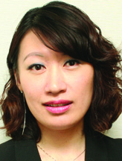

全新健康及營養產品巡禮
Health & Nutrition New Products Spotlight
Emmy Yeung
產品拓展經理
Product Marketing Manager
本簡報中提到的收入等級純屬舉例說明，無意代表美安香港超連鎖™店主的一般收入，也無意表示任何超連鎖™店主皆可賺取同等收入。美安香港超連鎖™店主的成功與否，取決於其在發展事業時的努力、才能與投入程度。
The income levels mentioned in the following presentation are for illustration purposes only. They are not intended to represent the income of a typical Market Hong Kong UnFranchise ™Owner, nor are they intended to represent that any given Independent UnFranchise ™ Owner will earn income in that amount. The success of any Market Hong Kong Independent UnFranchise ™ Owner will depend upon the amount of hard work, talent, and dedication which he or she devotes to building his or her Market Hong Kong Business.

Slide 2
2016 VS. 2017
SALES GROWTH OF DIFFERENT PRODUCT LINES
↑10.4%
↑22.6%
Isotonix®
TLS® Weight Loss Solution
↑12.0%
↑31.0%
DNA Miracles®
Motives® Cosmetics

Slide 3
Fertility Rate of Different Age Groups
Childbearing Ages
$12,400
↓75%
↑64%
Age 15 – 24
Age 15 – 19
Age 30 – 34
$17,600
Age 25 – 34
↓77%
↑111%
$19,700
Age 20 – 24
Age 35 – 39
Age 35 – 44
Source: https://www.statistics.gov.hk/pub/B71512FB2015XXXXB0100.pdf
Notes:
https://www.statistics.gov.hk/pub/B71512FB2015XXXXB0100.pdf

Slide 4
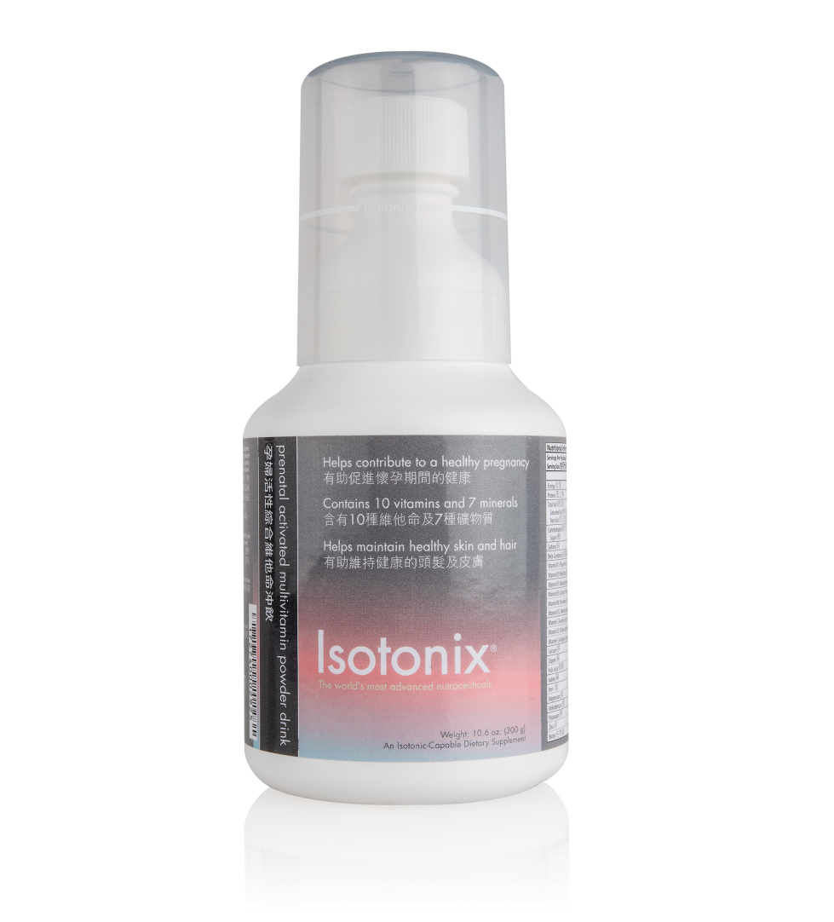
New Product Spotlight
Isotonix® Prenatal Activated Multivitamin Powder Drink

Slide 5

全新健康及營養產品巡禮
Health & Nutrition New Products Spotlight
Stephen Ngan
保健營養市場推廣部主管
JAS & Associates
本簡報中提到的收入等級純屬舉例說明，無意代表美安香港超連鎖™店主的一般收入，也無意表示任何超連鎖™店主皆可賺取同等收入。美安香港超連鎖™店主的成功與否，取決於其在發展事業時的努力、才能與投入程度。
The income levels mentioned in the following presentation are for illustration purposes only. They are not intended to represent the income of a typical Market Hong Kong UnFranchise ™Owner, nor are they intended to represent that any given Independent UnFranchise ™ Owner will earn income in that amount. The success of any Market Hong Kong Independent UnFranchise ™ Owner will depend upon the amount of hard work, talent, and dedication which he or she devotes to building his or her Market Hong Kong Business.

Slide 6
NUTRITIONAL NEEDS DURING PREGNANCY
Energy:
First Trimester – no change
Second Trimester – increases 280 kcal/day
Third Trimester – increases 475 kcal/day

Slide 7
NUTRITIONAL NEEDS DURING PREGNANCY
Protein:
Increases from 46 g/day to 71 g/day

Slide 8
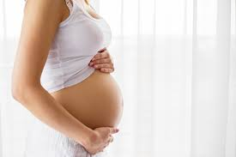
VITAMIN AND MINERAL REQUIREMENTS
IN PREGNANCY
Pregnant women are at increased risk for folic acid, iron and calcium deficiencies

Slide 9
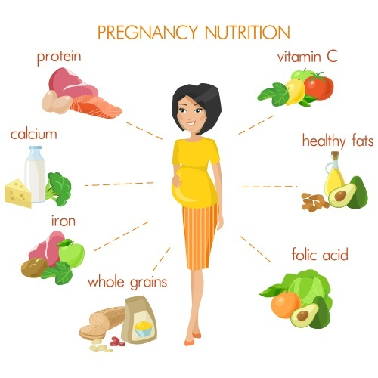

Slide 10
RECOMMENDATIONS
Folate – increases to 0.6 mg/day
Iron – increases to 27 mg/day
Calcium – 1000 mg/day
Magnesium – increases to 360 mg/day
Vitamin C – increases to 85 mg/day

Slide 11
FOLATE REQUIREMENTS IN PREGNANCY
Adequate folate is critical before and during the first 4 weeks of pregnancy
Since 50% of pregnancies are unplanned and most women do not seek prenatal care until 8 weeks gestation, folate supplements prior to conception are critical to prevent Neural tube defects (NTD)

Slide 12
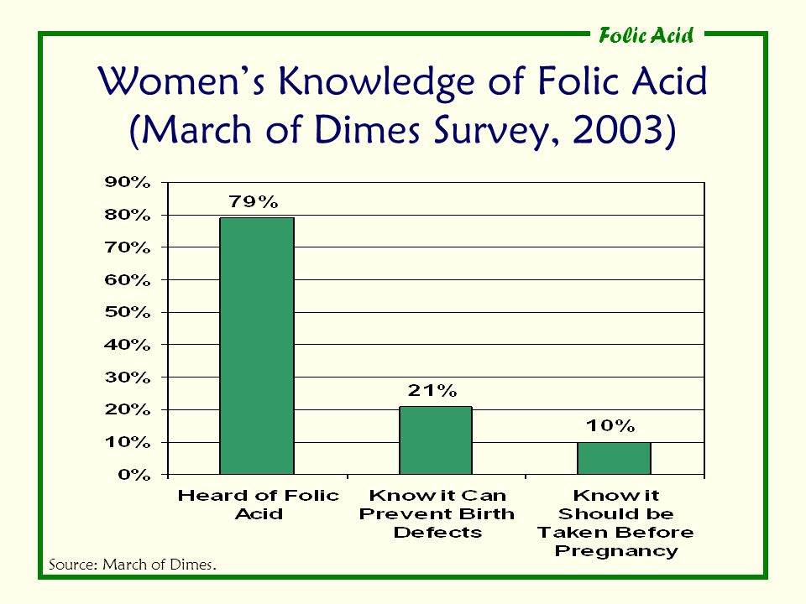

Slide 13
During pregnancy, the neural tube is formed from the 18th to the 26th day of gestation.

Slide 14
NEURAL TUBE DEFECTS (NTD) PREVENTION: ROLE OF FOLATE
Folate deficiency is the most common deficiency during pregnancy
NTD are thought to result from a dietary deficiency of folate and/or a genetic defect affecting folate metabolism

Slide 15
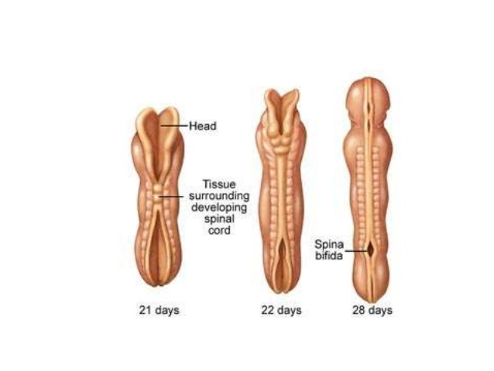
Source: The Luca Hill Acrania and Anencephaly Foundation

Slide 16
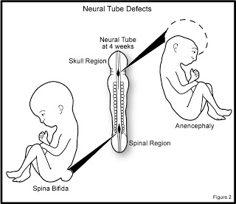
Source: http://www.thescienceofpregnancy.id.au/2011/04/

Slide 17
Serves as a co-factor (nucleic acids and amino acids) and therefore required during periods of rapid growth.
Increased maternal erythropoesis causes increased folate needs during second and third trimesters.

Slide 18
Folic acid is mainly found in fruits and vegetables. Dark, leafy greens, oranges, orange juice, beans, peas and Brewer’s yeast are the best sources.

Slide 19
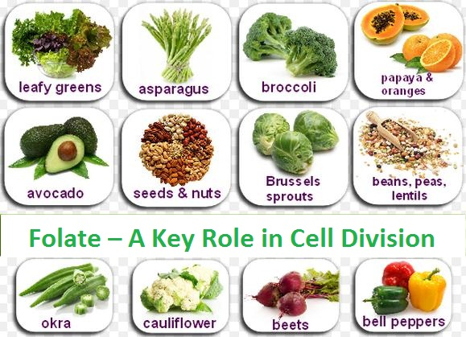

Slide 20
QUATREFOLIC®
Quatrefolic is the most active form of folate
Because this form is naturally present in the body, it is much more bioavailable for its biological action without having to be metabolized in the body.
This patented ingredient also provides greater stability and higher water solubility

Slide 21
IRON IN PREGNANCY
Iron is an essential element in all cells of the body
Iron needs increase from 18 to 27 mg/day during pregnancy
During pregnancy, maternal blood volume increases 20-30%
The demand for iron, essential for blood formation, is also significantly increased during pregnancy because the mother's blood volume increases and the fetal red blood cells have to be developed.

Slide 22
About one-third of the mother’s iron storage will be passed on to her developing baby in order to form its blood and to be stored for future use.

Slide 23
Poor iron intake - only 25% of females meet needs
Diet with low bioavailable iron

Slide 24
Deficiency increases risk of maternal and infant death, preterm delivery, and low birth weight babies.
Source: Saudi Med J. 2015; 36(2): 146–149. The impact of maternal iron deficiency and iron deficiency anemia on child’s health.

Slide 25
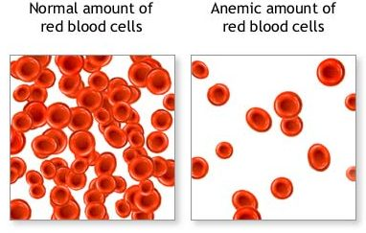

Slide 26
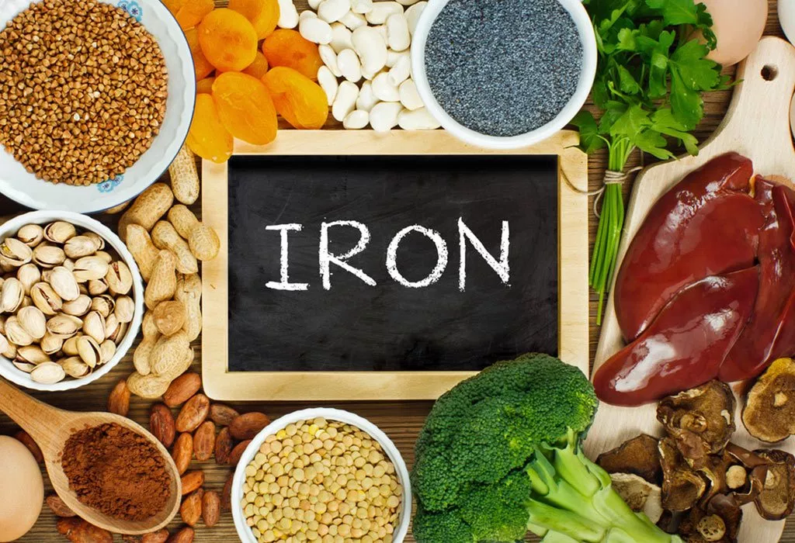

Slide 27
CALCIUM REQUIREMENTS
Calcium needs increase significantly during pregnancy.
Increased requirements during the third trimester
Supplementation shown to reduce hypertension during pregnancy

Slide 28
DRI Calcium Recommendation
19 - 50 year old: 1000 mg/day (pregnant and lactating)

Slide 29
Milk, yogurt (8 oz), cheese (1 oz) ~ 300 mg calcium
Broccoli, kale (1 cup cooked = 90 mg)
Bok choy (1 cup cooked = 180 mg)
Tofu (made with calcium citrate (½ cup = 260 mg)
Canned salmon (3 oz. = 180 mg)

Slide 30
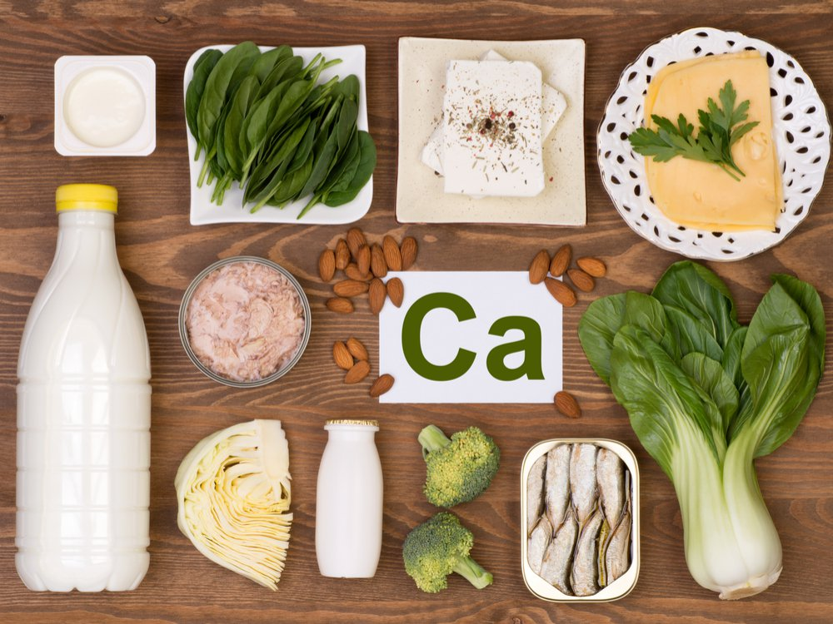

Slide 31
A substantial transfer of calcium occurs between the mother and the fetus throughout pregnancy, allowing the baby's bone and teeth formation.
In the first six months, the mother stores up calcium in her own bones.

Slide 32
When its skeletal growth reaches its peak in the last three months, the fetus draws on the mother's calcium storage. This is when the consumption of high calcium-containing foods such as milk and milk products must be increased since a calcium deficiency could harm the mother's teeth and bones.

Slide 33
MAGNESIUM
Magnesium promotes the health of bones (64% of the body's magnesium is concentrated in the bones). It supports normal bone structure and plays an essential role in more than 300 cellular reactions.
Magnesium may help maintain muscle comfort during pregnancy

Slide 34
VITAMIN C
The female body's requirement for vitamin C increases during pregnancy as this vitamin promotes the normal growth of the baby and supports building strong bones and teeth.
It also supports absorption of another key nutrient during pregnancy, iron.

Slide 35
全新健康及營養產品巡禮
Health & Nutrition New Products Spotlight
Emmy Yeung
產品拓展經理
Product Marketing Manager
本簡報中提到的收入等級純屬舉例說明，無意代表美安香港超連鎖™店主的一般收入，也無意表示任何超連鎖™店主皆可賺取同等收入。美安香港超連鎖™店主的成功與否，取決於其在發展事業時的努力、才能與投入程度。
The income levels mentioned in the following presentation are for illustration purposes only. They are not intended to represent the income of a typical Market Hong Kong UnFranchise ™Owner, nor are they intended to represent that any given Independent UnFranchise ™ Owner will earn income in that amount. The success of any Market Hong Kong Independent UnFranchise ™ Owner will depend upon the amount of hard work, talent, and dedication which he or she devotes to building his or her Market Hong Kong Business.

Slide 36
INTRODUCING…
ISOTONIX® PRENATAL ACTIVATED MULTIVITAMIN POWDER DRINK

Slide 37
PRIMARY BENEFITS:
Helps contribute to a healthy pregnancy
Contains 10 vitamins and 7 minerals
Helps maintain healthy skin and hair
Contains activated forms of select B-vitamins
Deficiencies of micronutrients during pregnancy are known causes of low birth weight

Slide 38
According to the American College of Obstetricians and Gynecologists (ACOG)
A pregnant woman needs more:
Calcium – at least 1,000 mg
Folic Acid – 600 µg/day vs. 400 µg/day
Iron – 27 mg/day
Protein – more is needed during pregnancy

Slide 39
NUTRIENT CONTENTS IN ISOTONIX® ACTIVATED MULTIVITAMIN POWDER DRINK
NUTRIENT | CONTENT IN PRODUCT | DIETARY REFERENCE INTAKES
Vitamin B1 | 3 mg | 1.4 mg; UL = Not Determine
Vitamin B2 | 3 mg | 1.4 mg; UL = Not Determine
Vitamin B6 | 4 mg | 1.9 mg; UL = 100 mg
Vitamin B12 | 12 mcg | 2.6 mcg; UL = Not Determine
Vitamin C | 120 mg | 85 mg; UL = 2,000 mg
Vitamin D3 | 1000 IU | 200 IU; UL = 2000 IU
Vitamin E | 30 IU | 22.5 IU; UL = 1,500 IU
Folic Acid | 810 mcg | 600 mg; UL = 1,000 mg
Calcium | 150 mg | 1,000 mg; UL = 2,500 mg
Iron | 20 mg | 27 mg; UL = 45 mg
UL = The maximum level of daily nutrient intake that is likely to pose no risk of adverse effects.
ND = Not determinable
Source: http://perinatology.com/Reference/RDApregnancy.htm
Notes:
http://perinatology.com/Reference/RDApregnancy.htm

Slide 40
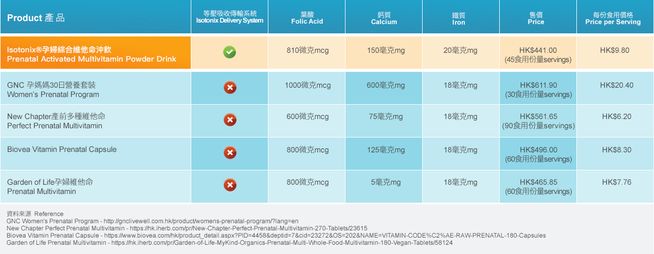
ISOTONIX® PRENATAL ACTIVATED MULTIVITAMIN POWDER DRINK
CODE: HK13077
UC: HK$315.00
SR: HK$441.00
BV: 29

Slide 41

Because every child is a miracle. Pediatrician-approved* and loved by moms everywhere.
*DNA Miracles products have been approved by US pediatricians.

Slide 42
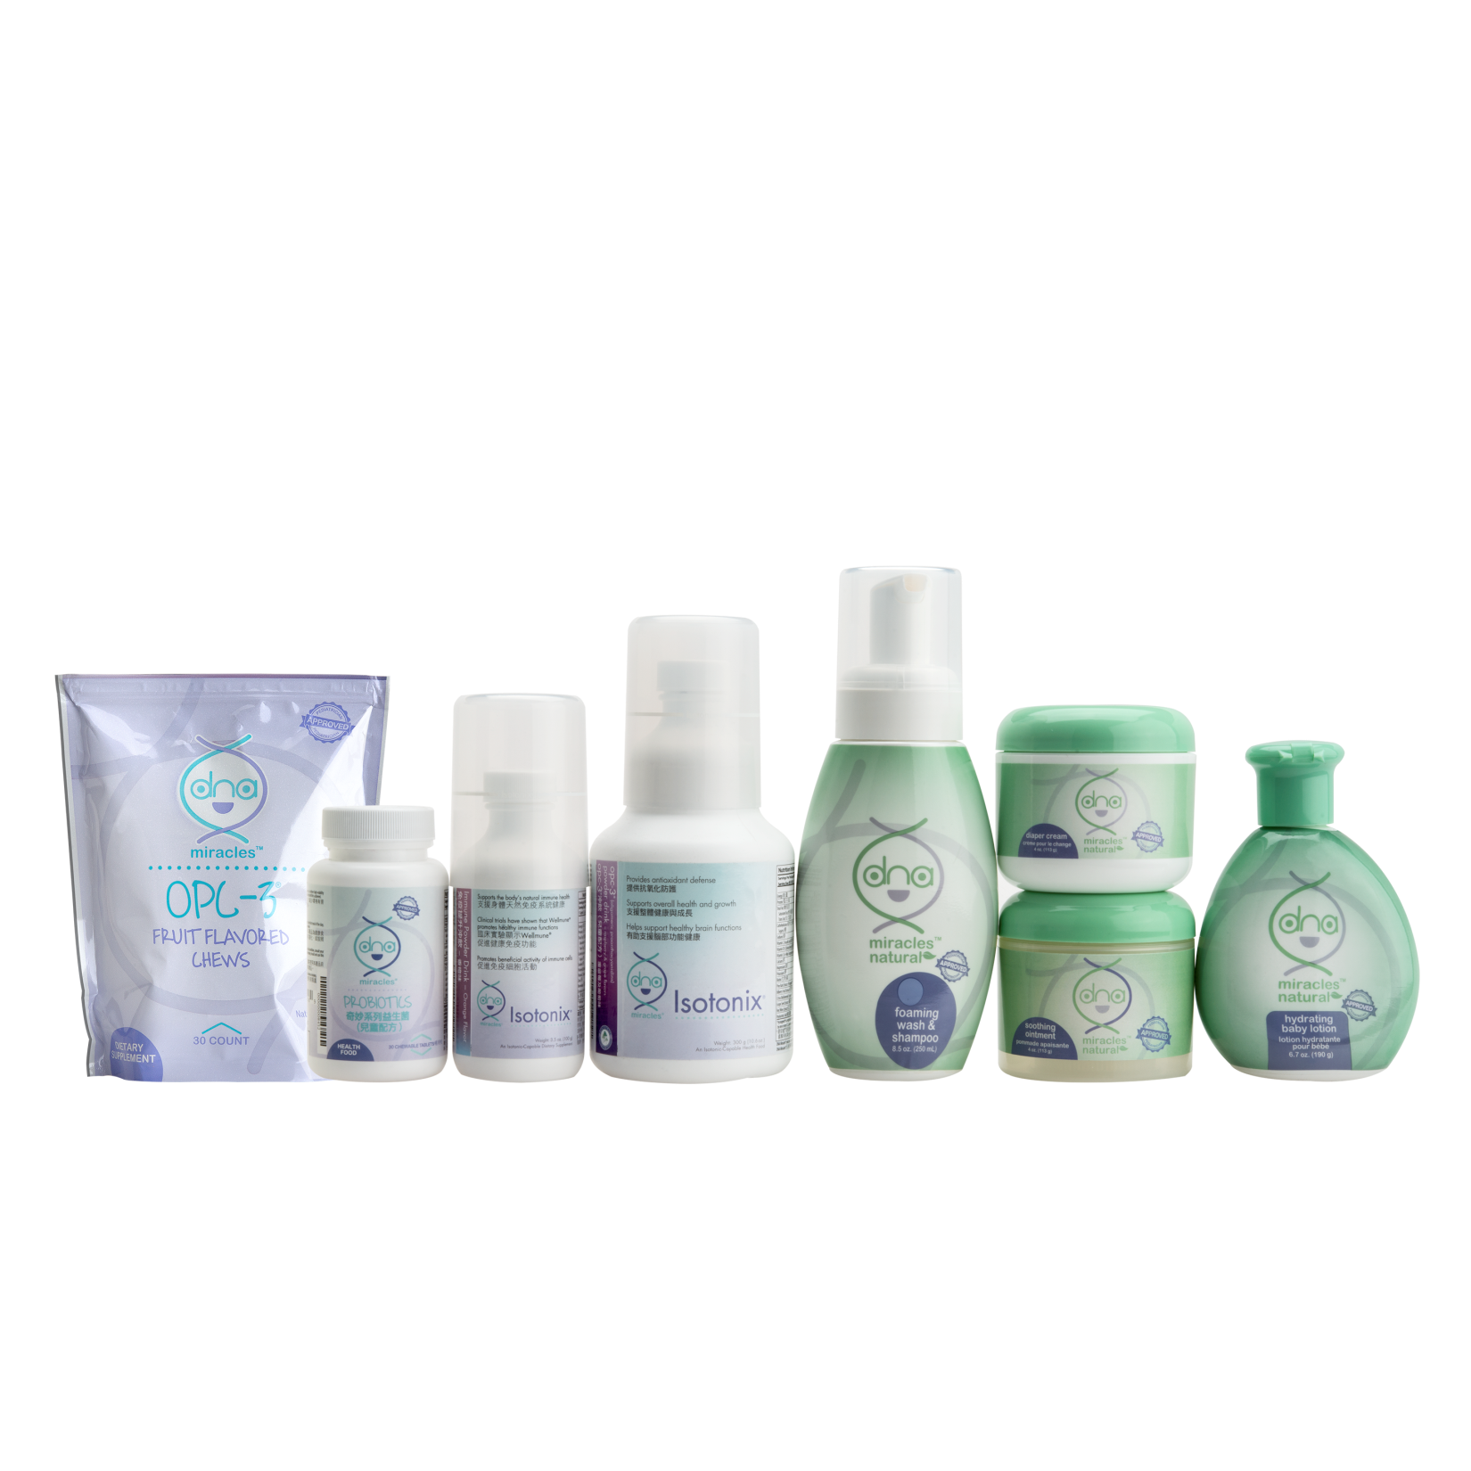

AVAILABLE PRODUCTS

Slide 43

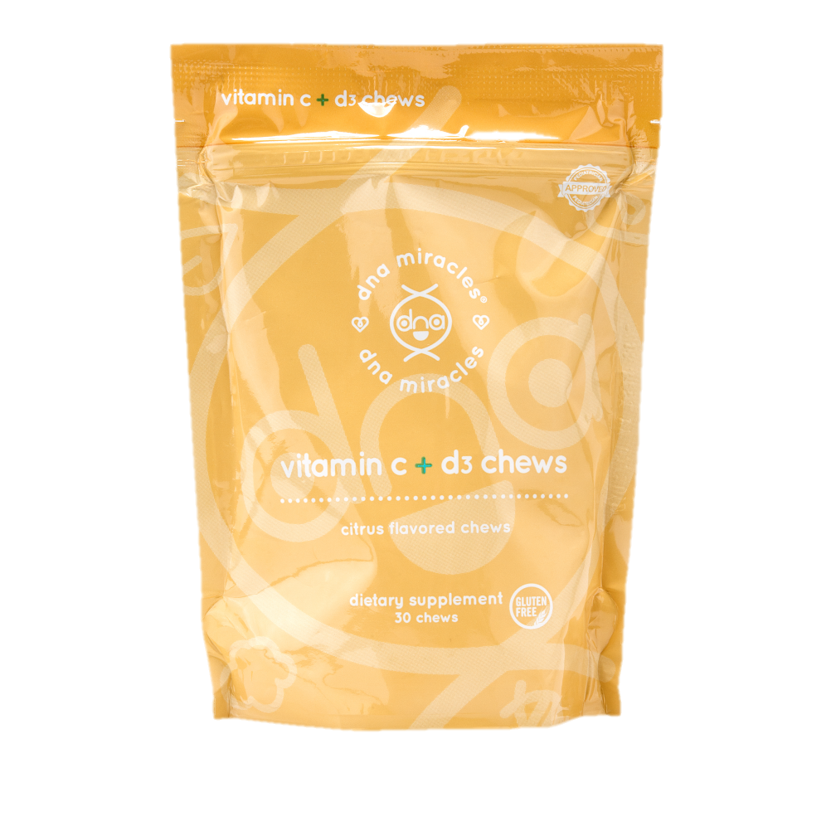
INTRODUCING…
DNA MIRACLES® VITAMIN C + D3 CHEWS

Slide 44
FUNCTIONS OF VITAMIN D
Fat-soluble vitamin that helps the body to absorb calcium and phosphorus
Important for building and keeping strong bones
Vitamin D is used to treat and prevent bone disorders
It is made by the body when skin is exposed to sunlight; sunscreen, clothing and limited exposure to sunlight may prevent us from getting enough from the sun
Source: https://www.webmd.com/drugs/2/drug-158788/childrens-vitamin-d-oral/details

Slide 45
INTAKE OF VITAMIN D
FOR CHILDREN
Does your child get enough vitamin D intake?
Sources: milk, fatty fish like tuna and salmon, beef liver, egg yolks etc…
The American Academy of Pediatrics (AAP) has increased the amount of vitamin D recommendations for children and adolescents in October 2014
Recommendation: 600 IU per day
Source:
https://www.healthychildren.org/English/healthy-living/nutrition/Pages/Vitamin-D-On-the-Double.aspx

Slide 46
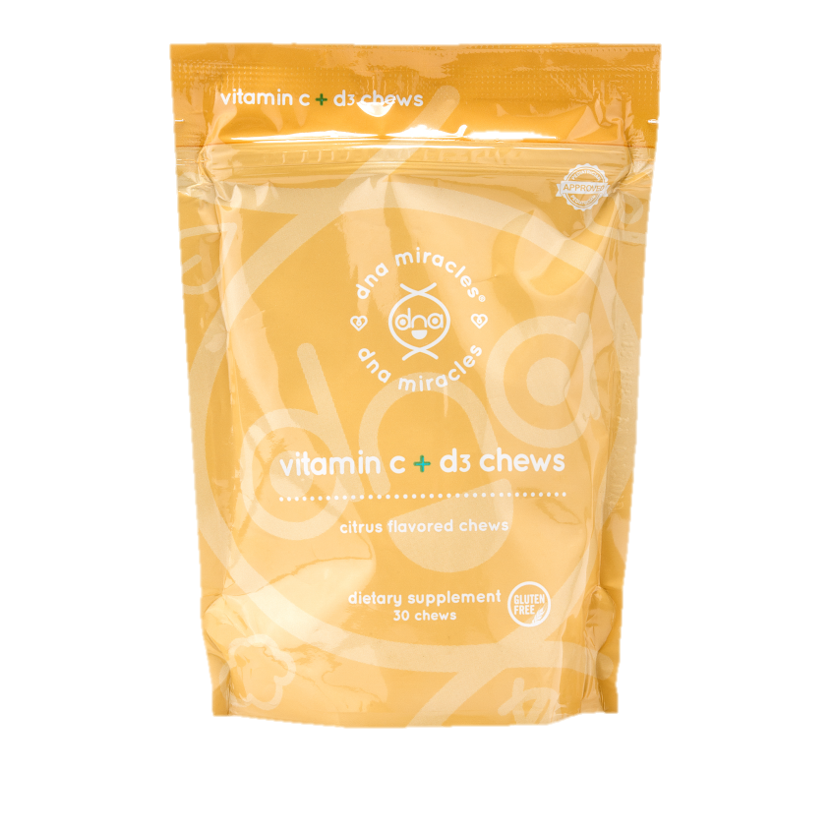
DNA MIRACLES® VITAMIN C + D3 CHEWS
  PRIMARY BENEFITS:
  Supports immune functions
  Supports skeletal health and growth
  Supports healthy teeth and hums
  Supports growth & strength of teeth and bones
  Supports healthy growth and development
  Provides antioxidant protection

Slide 47
DNA MIRACLES® VITAMIN C + D3 CHEWS
  KEY INGREDIENTS:
  Vitamin C – 120 mg
  Vitamin D3 – 600 IU
  Zinc – 3mg
  USAGE TIPS:
  Suitable for children ages 4 and older. Consume 1 chew daily. Can be taken with other DNA products.

Slide 48
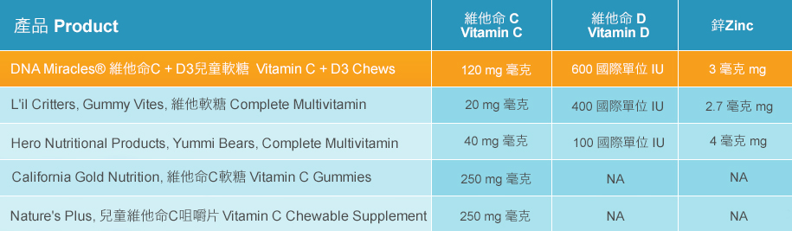
DNA MIRACLES® VITAMIN C + D3 CHEWS
CODE: HK6300
UC: HK$141.00
SR: HK$198.00
BV: 10

Slide 49
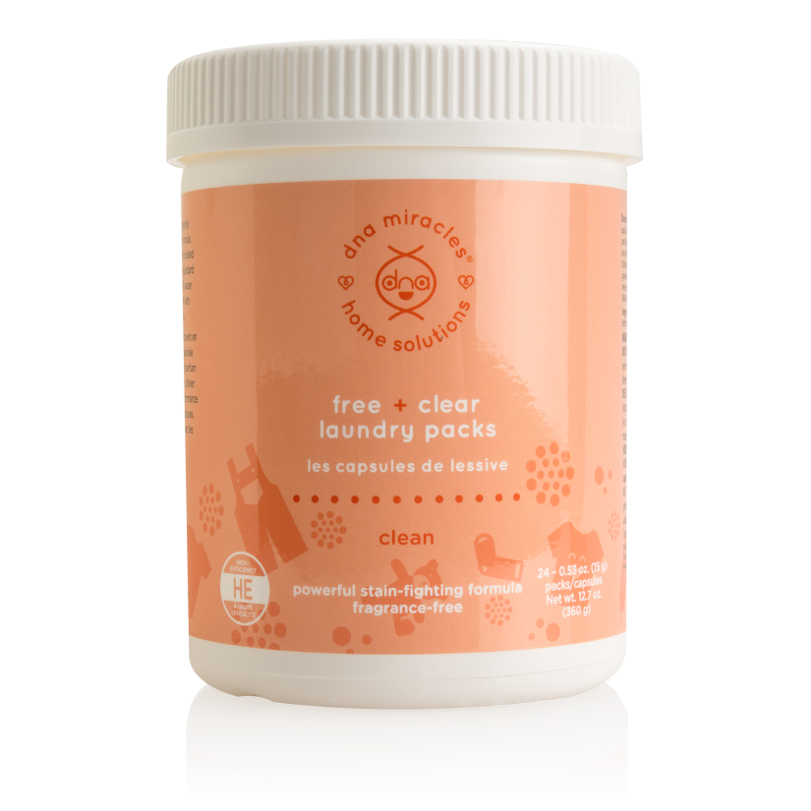
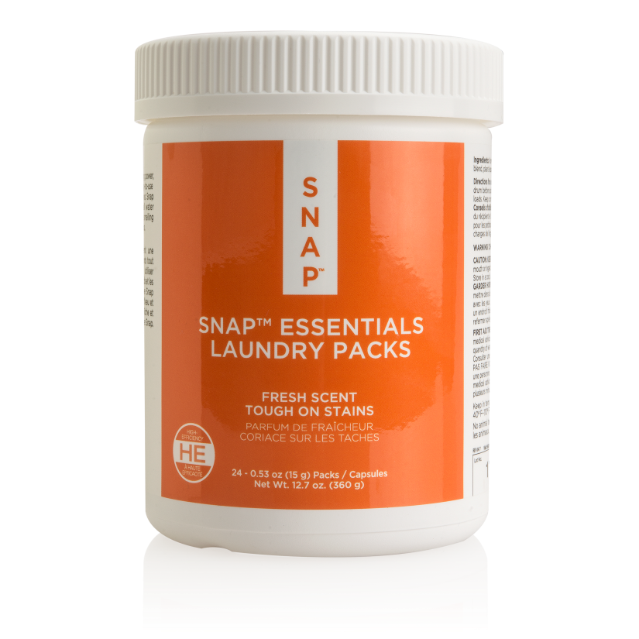
DNA MIRACLES® & SNAP® ESSENTIAL LAUNDRY PACKS

Slide 50


Introducing the new laundry packs
24 LOADS OF LAUNDRY
OR

Slide 51
Dna miracles® free + clear laundry packs
Pre-measured, convenient packs
Fragrance free
Powerful stain-fighting formula
Safe for baby clothing and other delicate clothing
Eco-friendly
Free of phosphates, sulfates, formaldehyde, DEA, SLS & optical brighteners
Non-toxic & no artificial dyes
CODE: HK6955 UC: HK$88.00 SR: HK$125.00 BV: 5.0

Slide 52
Snap® ESSENTIALS LAUNDRY PACKS – FRESH SCENT
Pre-measured, convenient packs
Fresh scent
Powerful stain-fighting formula
Great in all water temperatures
Eco-friendly
Free of phosphates, sulfates, formaldehyde, DEA, SLS & optical brighteners
Non-toxic & no artificial dyes
CODE: HK6230 UC: HK$88.00 SR: HK$125.00 BV: 5.0

Slide 53

2018 Product Symposium
Date: June 30, 2018 – July 1, 2018
Address: Science Park, Shatin
Ticket Price: HK$1,360.00
Code: 2188_HKGPS18

Slide 54


Transitions Lifestyle System®
Weight loss isn’t magic...it’s just science.

Slide 55


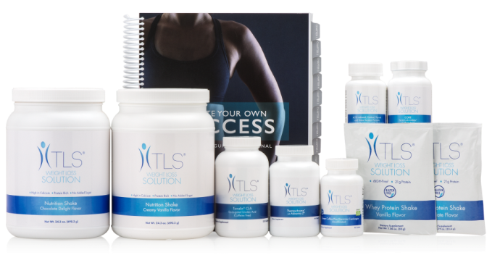
WELCOME
to the TLS® Family...
D

Slide 56



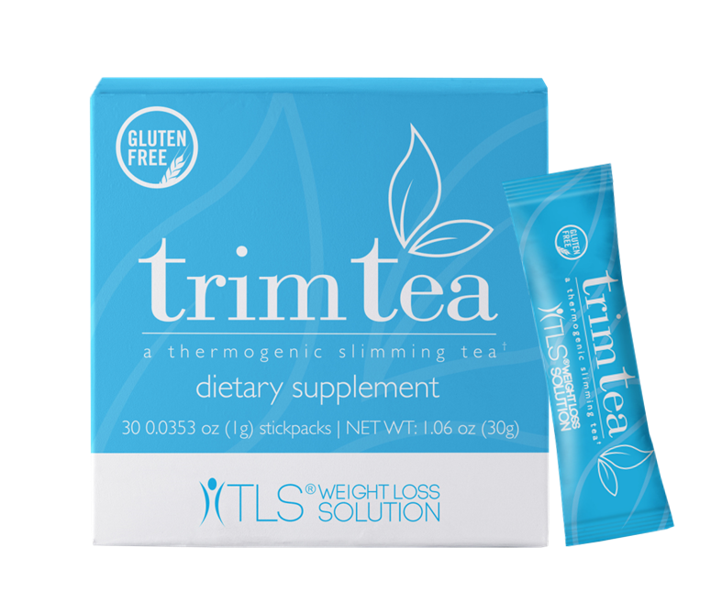
Promotes healthy weight management
Helps reduce body fat
Helps and supports weight loss
Promotes a multi-functional approach to effective weight loss
Great for caffeine drinkers or those who drink tea or those who want low caffeine amounts
WellTrim™ iG is a trademark of Icon Group, LLC.
IGOB131® is a registered trademark of Gateway Health Alliances, Inc. and is protected under U.S. Patent 7,537,790.

Slide 57
Ingredients:
Black tea extract – 700 mg
WellTrim™ iG (IGOB131®) African Mango Seed Extract – 300 mg
Usage:
Mix 1 stick pack in 6 oz. of cold or hot water. Best if taken 30 – 60 minutes before a large meal.
WellTrim™ iG is a trademark of Icon Group, LLC.
IGOB131® is a registered trademark of Gateway Health Alliances, Inc. and is protected under U.S. Patent 7,537,790.

Slide 58
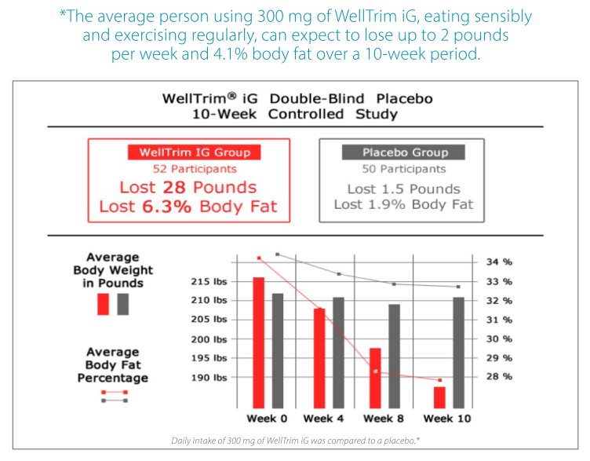

Slide 59

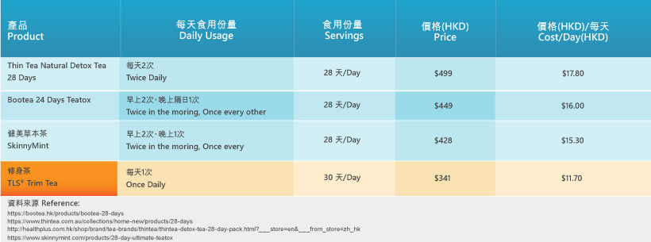
Code: HK6610
UC: HK$243.00
SR: HK$341.00
BV: 20

Slide 60
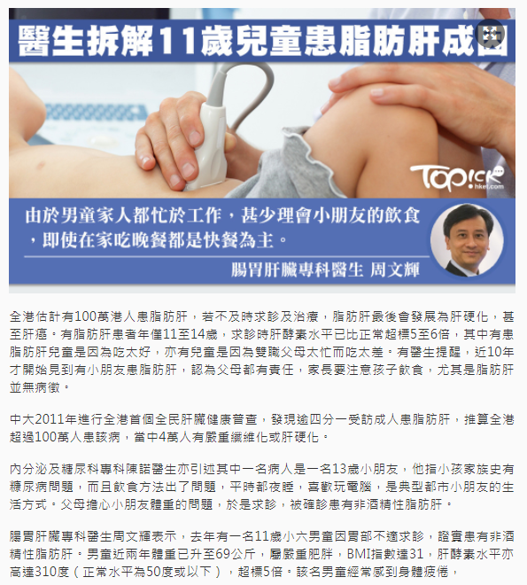

https://www.sundaykiss.com/%E5%81%A5%E5%BA%B7/%E8%84%82%E8%82%AA%E8%82%9D-%E7%87%9F%E9%A4%8A%E5%B8%AB-%E5%BC%B5%E6%95%AC%E8%BB%92-ctl03/
https://topick.hket.com/article/2024727/?r=mcsdfb

Slide 61
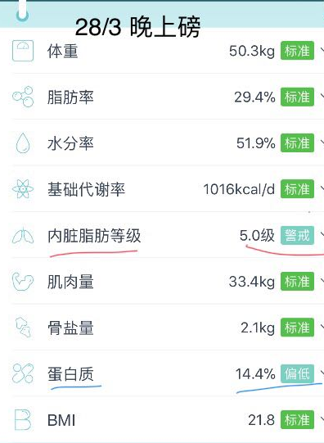
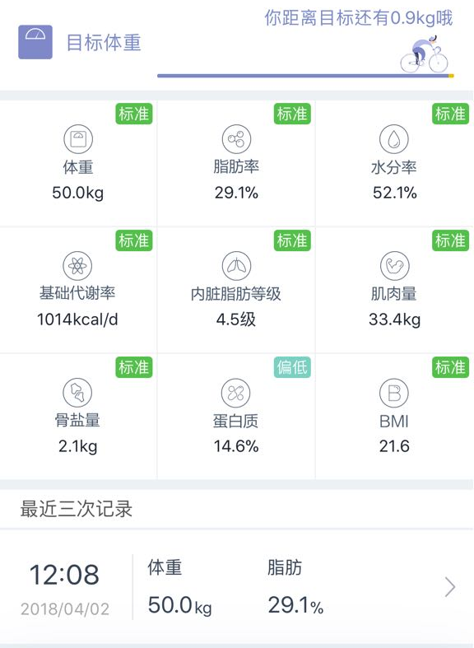
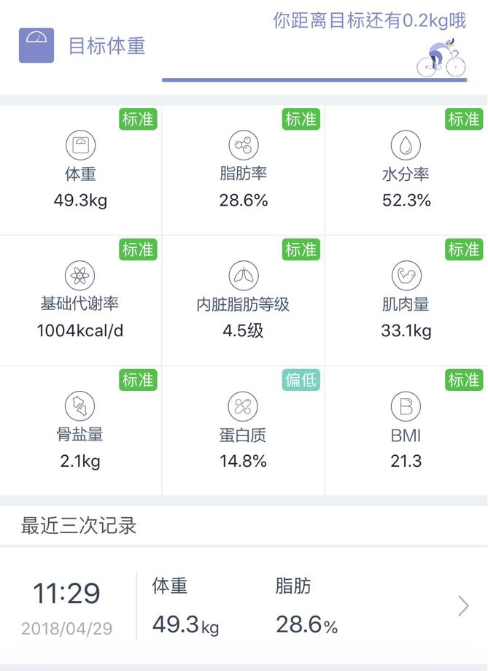
CHRISTINA LI
1 MONTH EXPERIENCE
2018/04/02
2018/04/29

